Slide 1
Risc-V Profiles & Extension
Enrico Piovesana Fernandes

Slide 2
What is a Profile?
Profiles are:
  A base ISA (e.g., RV64I, RV32I)
  A group of mandatory extensions
  A group of optional extensions
Specific Profile specifications are managed by the RVIA

Slide 3
Goal of Profiles
Reduce optionality and granularity
Favors compatibility without being too restrictive
Raise RISC-V Capability over time

Slide 4
RVA Profiles
“Risc-V Application” Profiles
Ex:
  RVA23U64
  RVA23S64

Slide 5
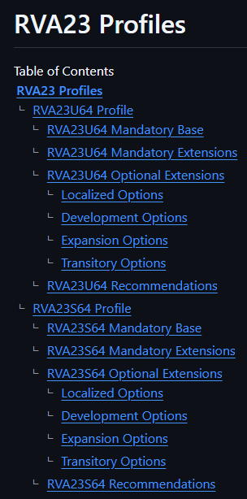

Slide 6
Profile Naming Conventions
RV: Represents Risc-V
Profile Family: I, A, M or E (I for generic unprivileged instructions, A for Application Processors)
YY: Last 2 digits of calendar year when the profile was last ratified
Base ISA XLEN Specifier: 32 or 64 bits
Privilege Modes: U (User/Application), S (Supervisor), M (Machine)

Slide 7
Profile Examples
RVI20U32 (32b generic RISC-V unprivileged instructions)
RVA20S64 (64b application-processor supervisor profile)

Slide 8
Compatibility
Ratified Profiles are (mostly) backwards compatible
Highest Division: Base ISA (Profile)
Privilege Mode (Higher ones include lower ones, M>U>S)
Profile Family
64/32/16 Bits
Release Year

Slide 9
